Slide 1
Cole Stevens, Mikaela Dobie, William Beaupre
Machine / Deep Learning
With Large Language Models
Training & Fine Tuning Meta’s LLAMA models for Detecting Fake News

Slide 2
WHAT’S
TO
COME
Introduction: Purpose & Goals
Definitions
Where to start?
4. The Process
5. Challenges & Setbacks
6. Results & Next Steps
Notes:
Cole Intro and goals
Mikaela Process, Challenge with Data
Will Rest of challenges, Results, Next Steps

Slide 3
What’s the Problem?
Fake news impacts everyone!

Slide 4
The Current Approach
Platforms like Snopes/Politifact
Rely on manual fact-checking
Time-consuming
Labour-intensive
Reading the story
Checking sources
Come to a conclusion
The fact-checker must read through the story to understand all of the factual claims being made.
To verify each factual claim the checker would need to conduct research, which is time-consuming.
Not all stories are black and white; stories can contain some half-truths.

Slide 5
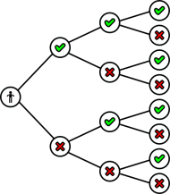
Can AI Do It?
Limitations and challenges of manual fact-checking
AI’s potential to identify patterns?
Goal: train AI to predict truthfulness of news stories

Slide 6
What are Large Language Models (LLMs)?
Advanced AI tools for text understanding and generation
Example: ChatGPT (GPT-4)
Designed to mimic human-like text

Slide 7
How LLMs Work
Input gets broken into smaller units (tokens)
Tokens can be words or characters
The model analyzes tokens and generates a response based on training
User Input: the user sends a query or input text, and the LLM receives the input
Processing & Generating: the LLM processes the numbers to understand context and generates response tokens
1
3
2
4
Tokenization/Embedding: tokenizer breaks the input text into tokens, which are turned into numbers
Response Output: response tokens are converted to readable text, and the LLM sends back the text as a response

Slide 8

Why LLaMA?
Developed by Meta: cutting-edge technology
“Large Language Model Meta AI”
Efficient and adaptable compared to other models
Available in various sizes and complexities

Slide 9
First Goal: Model Comparison
Compare different LLaMA versions (e.g., LLaMA 2 7b, LLaMA 3.2 1b)
“Version” = release date, “b” = billions of parameters
More parameters = better performance, higher computational cost

Slide 10
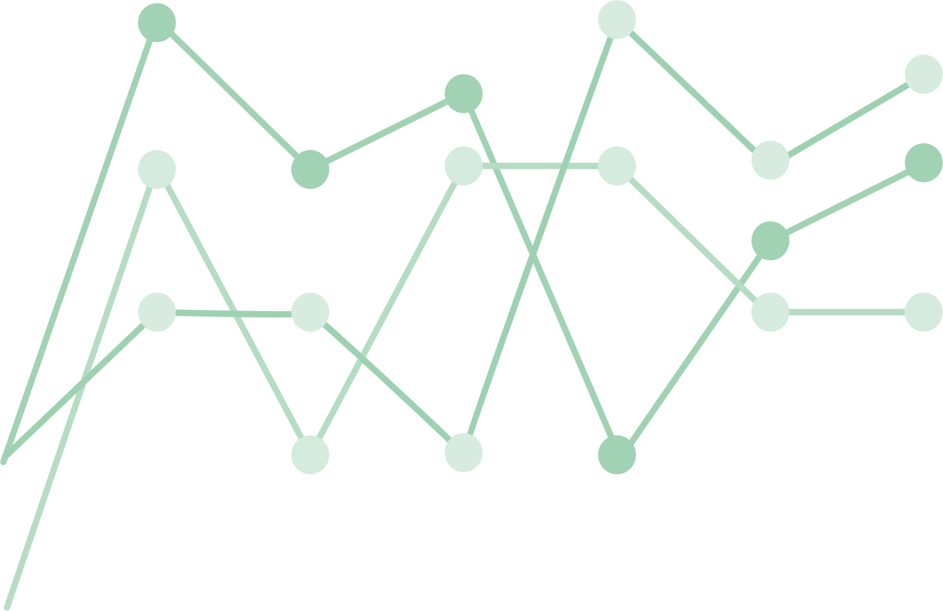
Second Goal: Optimizing Performance
Fine-tune the model on specific datasets
Adjust hyperparameters (e.g., learning rate, batch size)
Goal: improve accuracy and effectiveness

Slide 11
Key Takeaways
Two key questions:
Which LLaMA model is best for fake news detection?
How much can fine-tuning improve accuracy?

Slide 12
THE
START

Slide 13
CRIME
HEALTH
SCIENCE
SOCIAL
POLITICS
Notes:
GOALS: talk about the goal of the project and why the category labels matter

Slide 14
STEP
1
THE DATA

Slide 15
Import the Data
Preprocess
Combine and Use
The Data

Slide 16
STEP
2
THE MODEL

Slide 17
Choose the right model:
Parameters & Resource Consumption
LLAMA2 -7B & LLAMA3.2 -1B
Notes:
Parameters are the core components of a machine learning model, defining its capacity to learn and generalize from data. Larger parameter counts generally allow models to capture more complex patterns, but they also require more computational resources to train and infer.

Slide 18
STEP
3
TRAINING

Slide 19
Train, Tune, Evaluate
GOOGLE COLAB & UNSLOTH
Notes:
Because the models require more resources than the average person has available we made use of Google collab and the Unsloth Library on Python. Using these components we are able to store our data on Google drive, work remotely with access to servers much more powerful than we are equipped with. Even so training a model can be very expensive resource wise which is why we are using the Unsloth Library which speeds up the training process allowing us to handle greater loads of data at reasonable speeds. Fine-tuning: [WE NEED TO DO THIS] Evaluate: As the data we collected is split into training and testing data, we have the model make predictions on the verity of the data and calculate the accuracy, precision, recall, and F1 score after each training set - epoch.

Slide 20
CHALLENGES
&
SETBACKS
Notes:
No project can ever run smoothly, this will be a runthrough of every challenge we faced and how we overcame them

Slide 21

The Data
1
PHEME
Notes:
Professor Alnabhan was nice enough to provide us with links to all the datasets we are using in this study. Some did require a login or a python script but ultimately they were all open access datasets that we were able to download. One dataset however is Pheme which is a collection of organized tweets that pertain to Donald Trump and American Politics. We had a bit of an issue with the size of the file as GitHub did not support its upload and the usability of the data as we have mostly only worked with dataframes and csv files, Pheme is stored in JSON files of annotations of the tweets. After numerous attempts at coding a script to convert it, Prof Alnabhan helped us by providing a script he has used before and with some minor changes we were able to write the data into a single, much more condensed csv file.

Slide 22
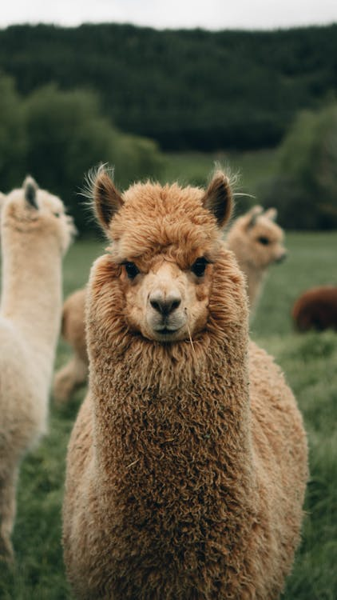
The Model
2
LLAMA
Notes:
Downloading model and getting it to run, was probably the biggest set back we encountered. The models are fairly new in terms of how common it is to use them. Originally we looks at the parameters and downloaded LLAMA2-70B. However after we wasted a lot of time in the downloading process we came to realize that the model was too large for anyone without numerous resources to use. After that we tried with LLama2-7B and Llama3-1B which are much easier models to work with size wise, however a regular computer does not have a GPU capacity large enough to run the model, let alone train it is a usable amount of time. To solve this issue, we decided to use Google Collab which allows us to remotely access servers with two or four times the GPU capacities our own systems have. Though it wasn’t a miracle fix as we were faced with the drawback of costs as the free version does not have the capacity requirements need for this project and the lengthy runtimes of training the model made the cost of running 1 epoch (without knowing if we had errors in our code) approximately $3, which is absurdly expensive in a project that requires us to run this code hundreds of times. Through this setback we discovered Unsloth which reduced our training runtimes from hours to minutes.

Slide 23
Fine-Tuning and Evaluation
3
Hyperparameters & Batch Evaluation
Notes:
Although we solved a big issue with runtime and resource capacity, we still meet with setbacks as the process of fine-tuning a model and evaluating it takes is very expensive in terms of time and resource consumption. We have yet to implement a functional and efficient hyperparameter search method, we did manage to stay within our limits of resources by using batchsizes for our evaluation. We did need to play around with those parameters a bit as the larger batch sizes use more resources but are ultimately faster. We ended up using 8 as our main size and by doing so we were able to evaluate the fully concatenated dataset (~139000 rows).

Slide 24
Results

Slide 25
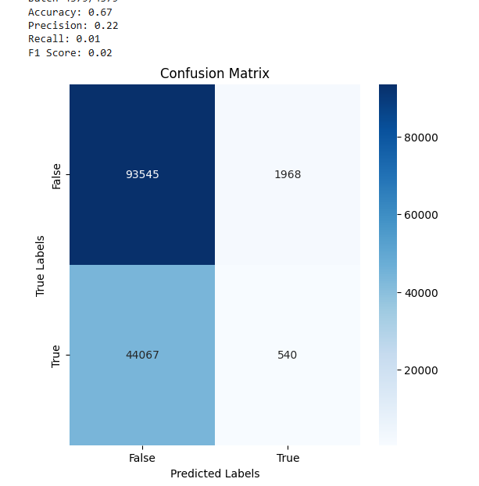
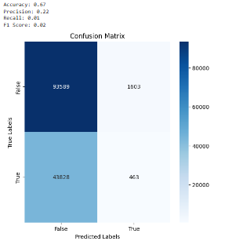
Untrained Model
Llama2 - 7B
Llama3.2 - 1B

Slide 26
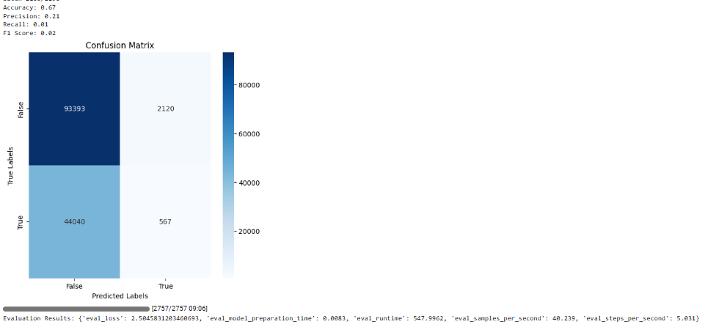
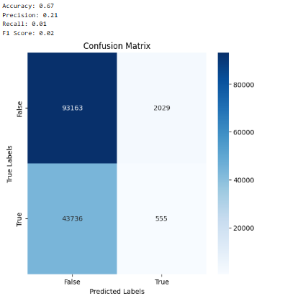
Trained Models
Llama2 - 7B Epoch 1
Llama3.2 - 1B Epoch 1

Slide 27
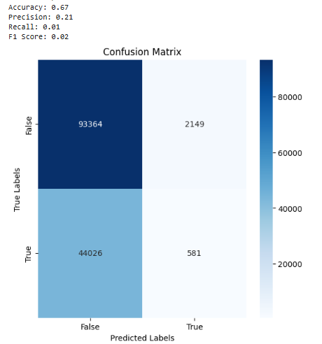

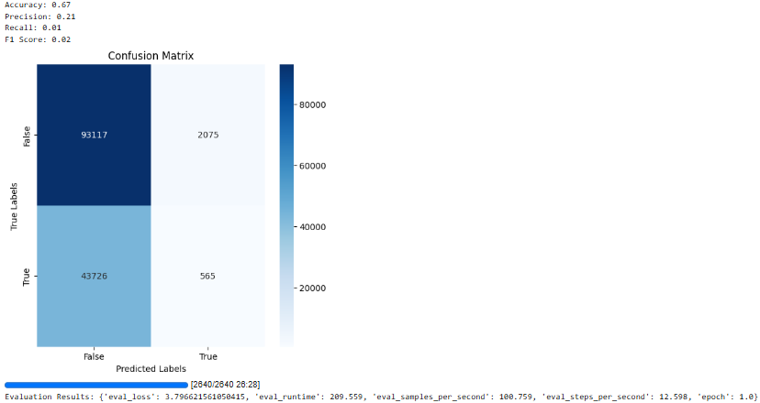
Trained Models Continued
Llama2 - 7B Epoch 2
Llama3.2-1b 2 Epoch
Llama3.2 - 1B Epoch 4

Slide 28
Next
Steps!

Slide 29
THANKS
FOR
LISTENING

Slide 30
SPECIAL THANKS TO
PROFESSOR MOHAMMAD ALNABHAN

Slide 31
RESOURCES:
Crime:
- FA-KES
- Snopes
Health:
- Covid Claims
- Covid-19 Fake News Infodemic Research Dataset
- Covid FNIR
Politics:
- FakeNews
- ISOT (Multi-purpose dataset)
- LIAR
- Pheme
- Politifact
Science:
- Climate Dataset
- ISOT (the science part only)
Social Media:
- GossipCop
- ISOT (the social part only)

Slide 32
Continued:
https://clipart-library.com/clipart/297437.htm
https://pngtree.com/freepng/llama-png-with-ai-generated_14576182.html
https://www.pngall.com/wp-content/uploads/10/Line-Chart-Transparent.png
https://www.pexels.com/photo/red-blue-and-yellow-textile-5417837/
https://www.pexels.com/photo/brown-llama-3396661/
https://www.pexels.com/photo/white-paper-with-black-line-7172774/

